Slide 1
The Generator Module
This section will introduce you the generator simulation module.

Slide 2
Generator Module
Designed to model distributed generation and other DERs
Includes
  Solar and Inverter
  Wind Turbines
  Energy Storage and Battery
  Diesel (non-functional)
In development and not fully supported
  Does not come with standard distribution

Slide 3
How does it work?
Modeled as a negative load
  Most are treated as voltage dependent current injection
Components connect through meters, triplex_meters, or inverters to powerflow
Control algorithms can be explicitly written into generator code or included from another object

Slide 4
Example
Battery object
No particular chemistry
Controls are built-in
This one is operating in a “dispatch-able” mode
  scheduled power
Base efficiency is round-trip efficiency (inverter is not explicitly modeled)
object battery {
parent battery_meter;
name battery_central;
generator_mode CONSTANT_PQ;
V_Max 8000;
I_Max 250;
P_Max 250000;
E_Max 1000000;
base_efficiency 0.86;
parasitic_power_draw 190 W;
power_type DC;
generator_status ONLINE;
Energy 1000000;
scheduled_power 250000;
power_factor 1.0;
}

Slide 5
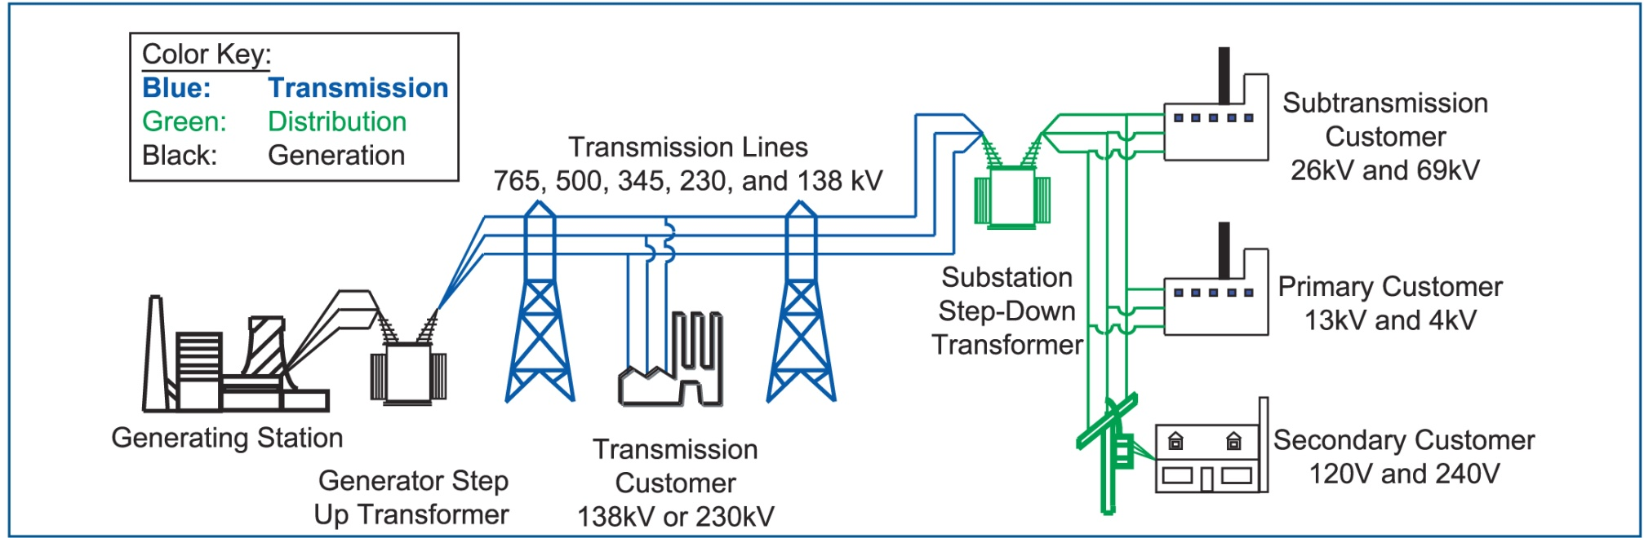
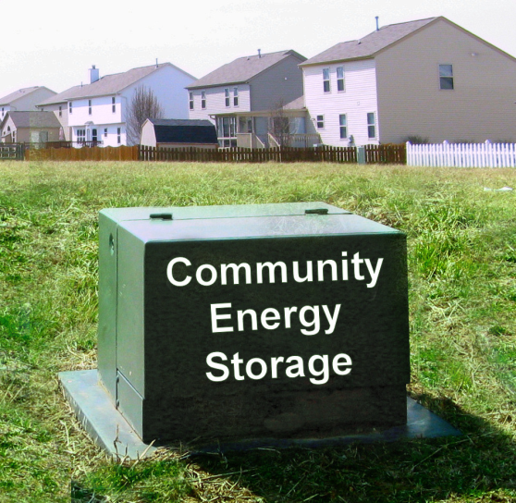
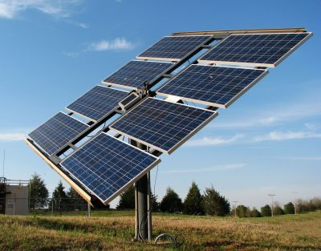
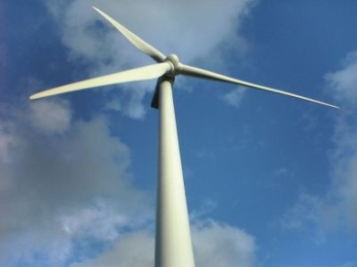
What is Community Energy Storage (CES)?
www.icandoitmyself.com
www.aeptechcentral.com

Slide 6
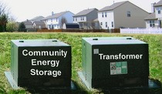
Why Community Energy Storage?
Advances in battery technology are beginning to make it cost effective
Enhancement of distributed / renewable generation support
Incentives are being provided by government and utilities
Reduced equipment costs / deferral of system upgrades
Improved reliability and temporary islanding support
Peak shaving / congestion management
Provides power directly to the load
Load response to market signals
Reduced system losses
Power quality control
Local voltage control
www.aeptechcentral.com

Slide 7
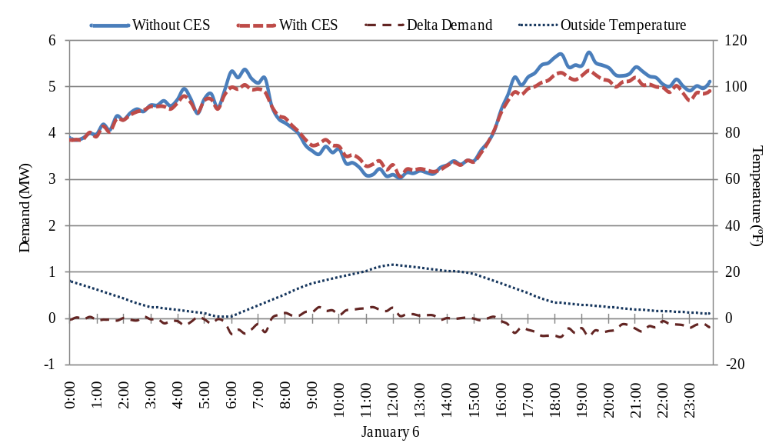
Example Analysis
Average Reduction: 158 kW
Peak Reduction: 347 kW
Average Reduction: 156 kW
Peak Reduction: 379kW
Substation Load on a Cold Day With and Without CES

Slide 8
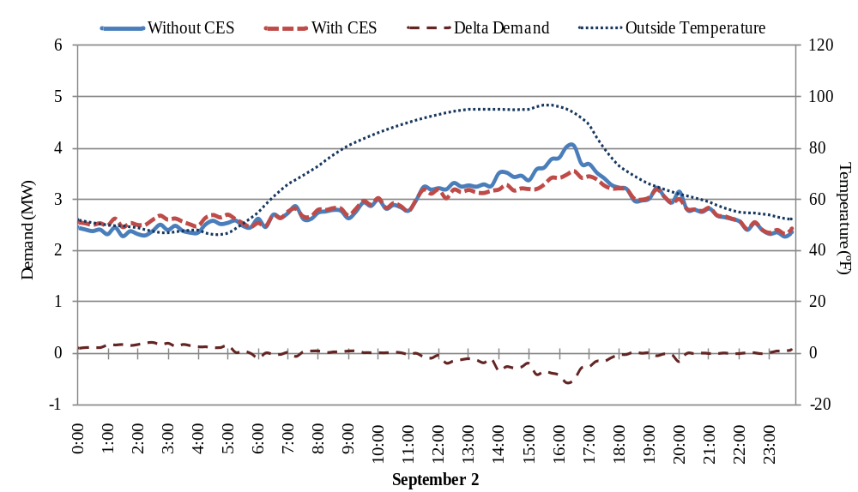
Example Analysis
Average Reduction: 207 kW
Peak Reduction: 583 kW
Substation Load on a Warm Day With and Without CES

Slide 9
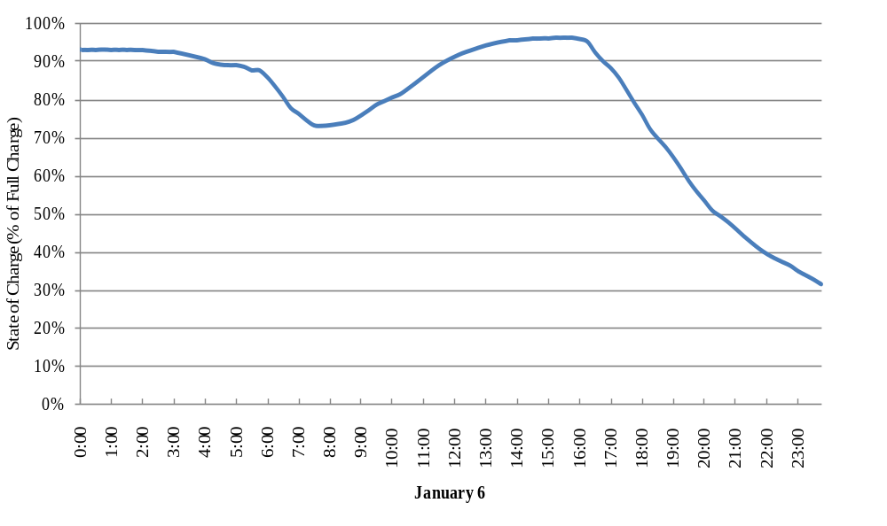
Example Analysis
Beginning of three day cold spell. This value continues to less than 10% before recovering for the morning peak.
Energy Available in Entire CES System on a Cold Day

Slide 10
Effects of Sensitivity on Losses and Energy Consumption
Equates to only 19.1 kWh on a 156,573 kWh feeder
Sensitivity | 0.5 | 1.0 | 1.8
Real Loss Reduction (%) | 1.41 | 2.15 | 2.89
Reactive Loss Reduction (%) | 1.46 | 2.22 | 2.99
Increase in Energy Consumption (kWh) | 53.7 | 112.1 | 434
Total Days Used | 262 | 313 | 359
Highest Winter DoD (%) | 49.0 | 91.5 | 100*
Highest Summer DoD (%) | 41.5 | 43.7 | 60.6
Can reduction of losses really be considered a benefit of energy storage when it only equates to 0.01% of total energy used?
Does it offset the increased energy consumption?

Slide 11
Demo
Look at the IEEE-13 demo cases to see how the battery is attached to the system. Observe the difference in demand on the IEEE-13 system without batteries, with distributed storage, and with centralized storage.

